Slide 1
Know Your Customer…Realize Your Revenue
Harippriya, Tulika, Priyanka, Sangeetha, Bharath
Access Manager Team

Slide 2
Problem Statement
Access Manager does not provide enough information about its users.

Slide 3
Why is this important?
Access manager is licensed per number of users.
Problem: No way to track the number of unique users
Result: Murky license negotiations. Revenue lost or unhappy customers.
Help administrators with capacity planning.
Help administrators make informed decisions about their network
Know the operating systems commonly used, locations of users, etc.

Slide 4
Hackfest Solution
Added reports that provide the needed information.
User data collected
Time of login
Client IP
OS – type, isPad, isMobile, isPhone
Browser
CPU
Java enabled
Language
Timezone
isFlashEnabled, isCanvas
Technologies Used:
Logstash
Elastic Search
Kibana

Slide 5
Demo

Slide 6
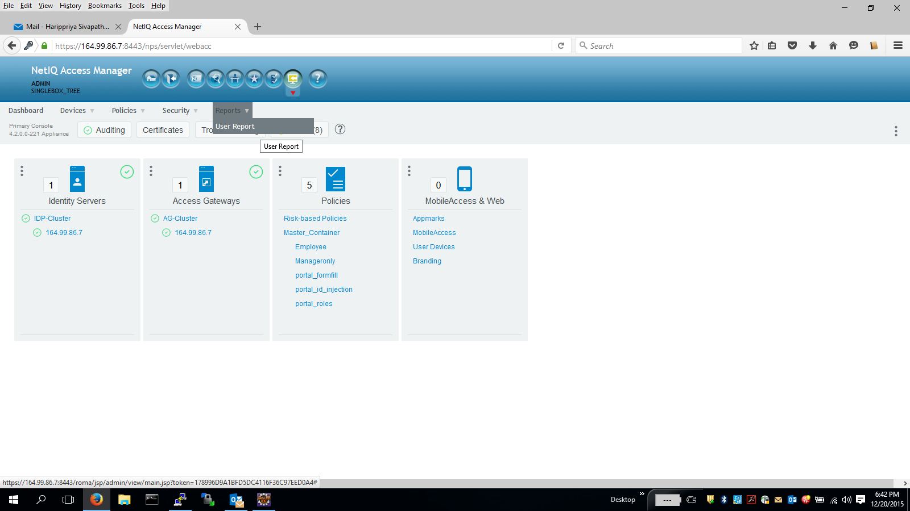

Slide 7
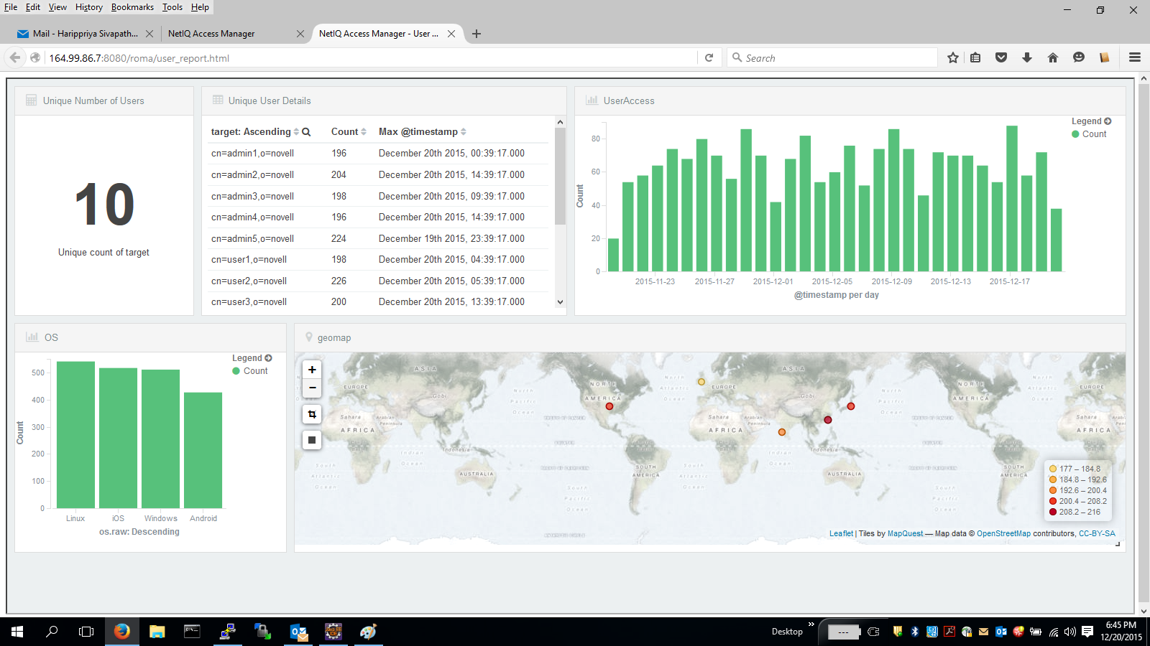

Slide 8
Thank You

